Slide 1
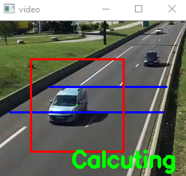
Vehicle Detection and Speed Tracking
Guided By:
Ankit Upadhyay
(Ass. Prof.)
Presented By: Animesh Jain
Brijesh Rathore
Harsh Verma
Himanshu Patel
Presented to:
Shraddha Kumar
(Prof.)

Slide 2
INTRODUCTION
Our aim is to build a tracking system which can identify the speed of a vehicle on the road.
For detection of vehicle, firstly we have to detect the vehicle by training the system using data set which will provide a rectangular frame capturing the vehicle then finding its centroid.
Using the arbitrary rectangular field on the road which will help in finding the speed of the vehicle, we will find the time and distance for finding its speed.
In recent years many researchers have worked on video cameras which are considered as a sensor for capturing and recognizing moving vehicle.

Slide 3
TECHNOLOGY & TOOLS
Language of choice : PYTHON.
Libraries : OpenCV, Time.
Platform for deployment : PYCHARM.
Additional Tool : Any Video Converter Ultimate
Dataset :https://medusa.fit.vutbr.cz/traffic/research-topics/detection-of-vehicles-and-datasets

Slide 4
APPLICATIONS
It can be used in traffic maintenance, detecting of vehicles with more than specified limit, traffic control, traffic monitoring, traffic flow, security etc.
This can be used for auto generation of challan using more camera and accuracy.
Can be used as traffic counters to count the number of vehicles passing on a highway.
The Number plate of vehicle which has crossed over speed limit can be sent to mobile of traffic police in the area using Android application.

Slide 5
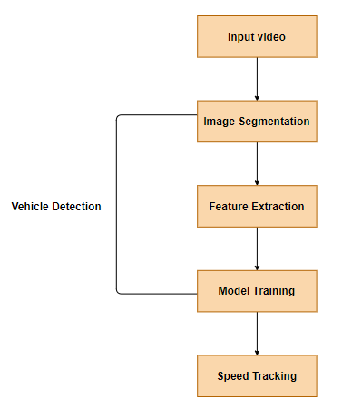
SYSTEM ARCHITECTURE

Slide 6
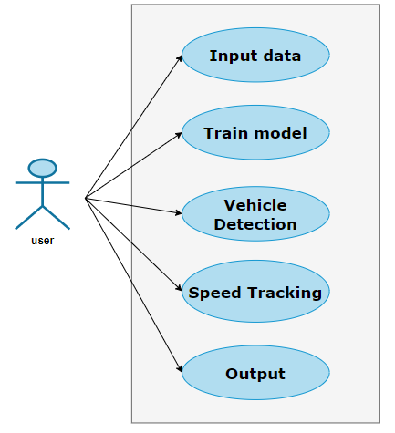
USECASE DIAGRAM

Slide 7
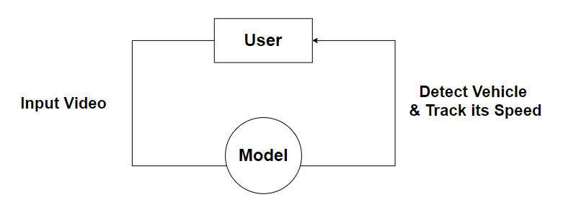
0 LEVEL DFD

Slide 8
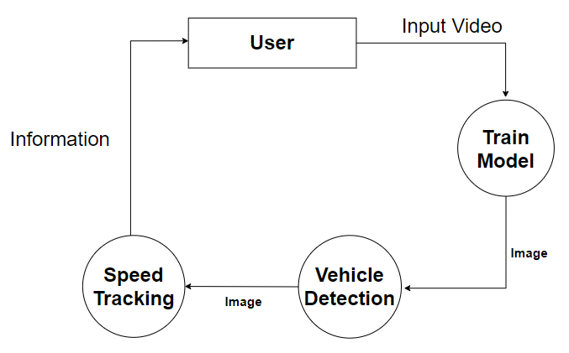
1 LEVEL DFD

Slide 9
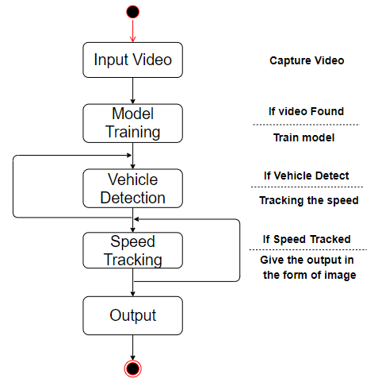
STATE TRANSITION DIAGRAM

Slide 10
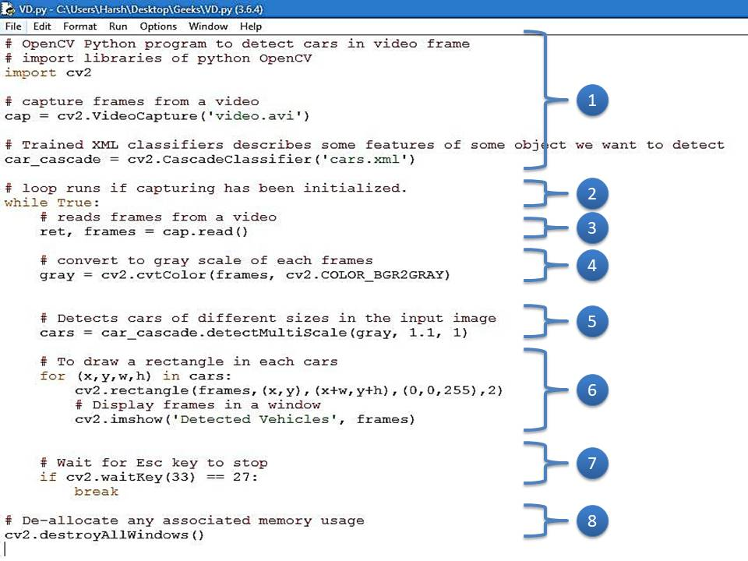
White Box Testing

Slide 11
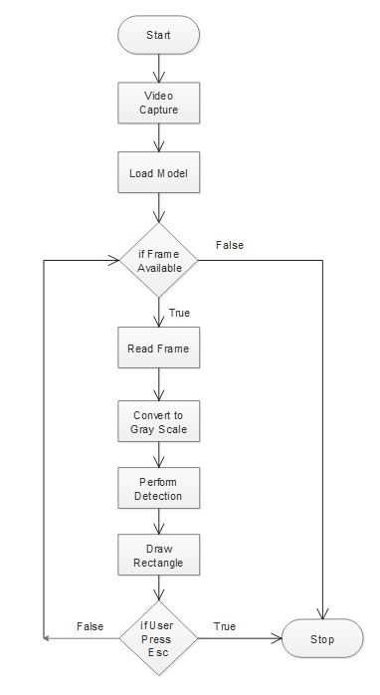
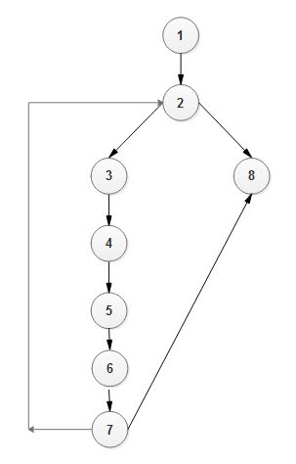
Flow Chart
Directed Graph

Slide 12
Cyclomatic Complexity
1. V(G) = P + 1, where P is the number of predicate nodes in the flow graph.
V(G) = 2+1 = 3.
2. V(G) = E – N + 2, where E is the number of edges and N is the total number of nodes.
V(G) = 11 - 10 +2 = 3.
3. V(G) = B + 1, where B is Number of non-overlapping regions in the graph.
V(G) = 2 + 1 = 3.

Slide 13
Test Cases for White Box Testing
Test Case Name: When frame is available in data set.
Expected Outcome: It should go in a loop for reading a frame & performing detection.
Actual Outcome: It is going in a loop for reading a frame & performing detection.
Path: 1 ➔ 2 ➔ 3 ➔ 4 ➔ 5 ➔ 6 ➔ 7 ➔ 2 …
Result: Pass.
Test Case Name: When frame is available in data set & Esc key is pressed after some time.
Expected Outcome: It should go in a loop for reading a frame & performing detection & stop after sometime.
Actual Outcome: It is going in a loop for reading a frame & performing detection & stop after sometime.
Path: 1 ➔ 2 ➔ 3 ➔ 4 ➔ 5 ➔ 6 ➔ 7 ➔ 8
Result: Pass.
Test Case Name: When frame is not available in data set.
Expected Outcome: It should break the loop and show the output.
Actual Outcome: It break the loop and show the output.
Path: 1 ➔ 2 ➔ 8
Result: Pass.

Slide 14
Black Box Testing
TEST CASE | TEST CASE DESCRIPTION | TEST DATA | EXPECTED RESULT | ACTUAL RESULT | PASS/FAIL
1. | Video containing vehicles | Video | Detect Successfully | Detect Successfully | Pass
2. | Video not containing vehicles | Video | Not Detected | Not Detected | Pass
3. | Video Quality | Video (More Blur) | Not Detected | Not Detected | Pass

Slide 15
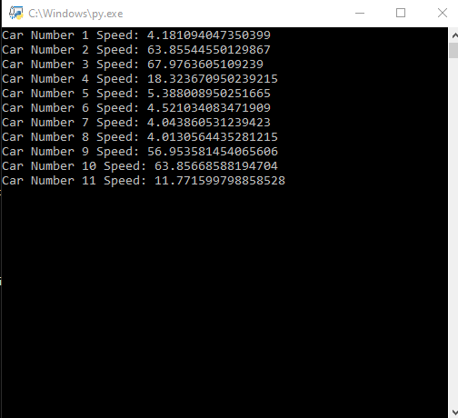
Output

Slide 16
REFERENCE
Reports:
“Motion-based Vehicle Speed Measurement for Intelligent Transportation Systems” by Ali Tourani, Department of Computer Engineering, University of Guilan, Rasht, Iran.
“Vehicle Tracking and Speed Estimation from Traffic Videos” by Shuai Hua, Manika Kapoor, David C. Anastasiu, Department of Computer Engineering, San Jose State University, San Jose, CA.
“Vehicle Detection, Tracking and Speed Measurement for Traffic Regulation” by Pulli Harsha Samhitha, Allu Naga Jyothi, Ramana Vesapogu, Manasa Mannem, S. Sri Harsha, V .R .Siddhartha Engineering College, JNTUK, Vijayawada, Associate Professor, Dept of Information Technology, V. R .Siddhartha Engineering College, Vijayawada, Andhra Pradesh, India
Website:
UML Diagrams- https://app.diagrams.net/

Slide 17

THANK YOU

